Slide 1
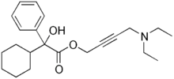
Oxybutynin 2.5 TID
Bu = bladder

Slide 2
Pharmacologic Options
Overactive Bladder
Overactive Bladder
+
Depression or Neuropathic pain
Ureteral Underactivity
(stress incontinence)
Oxybutynin IR (anticholinergic) 2.5 mg BID
Or
Tolterodine (muscarinic antag) 2 mg BID
Imipramine
Or
Doxepin
Or
Nortriptyline
Or
Desipramine
Alpha agonist
Dry mouth b/c
N-Desethyloxybutynin during 1st pass
Oxybutynin XL
Pros: less dry mouth
less CYP
Notes:
Tolterodine IR (competitice muscarinic receptor antagonist): 1st line therapy for UI in patients with symptoms of urinary frequency, urgency or urge incontinence

Slide 3
Incontinence: unable to control bladder
Urinary Incontinence (UI): Involuntary leakage of urine
Urgency: sudden compelling desire to urinate that is difficult to delay
Frequency: pee q8h
UUI = Urinary Urge Incontinence
bladder outlet obstruction (BOO),
Nocturia: urinating HS
Overactive Bladder: Syndrome characterized by urinary urgency + frequency + Nocturia + with/without UI + no actual cause
Detrusor overactivity: involuntary detrusor contractions during the filling phase of a urodynamic study. (diagnosis is important for treatment)
Overflow incontinence results when the bladder is filled to capacity at all times but is unable to empty, causing urine to leak from a distended bladder past a normal or even overactive outlet and sphincter

Slide 4
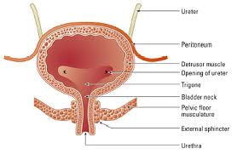
Da Bladda

Slide 5
Overactivity
Overflow Incontinence
Overactive Bladder Syndrome =
Urgency + frequency + Nocturia
+ w/ or w/o UI
+ No actual Cause
(general diagnosis)
Bladder Underactivity: Bladder is unable to empty → buildup of urine → Causes urine leak
Ureteral Overactivity: Urethra constricts (BPH or prostate cancer), causing a buildup of urine in bladder → Causes Urine leak
Detrusor overactivity: involuntary detrusor contractions during the filling phase of a urodynamic study
(specific diagnosis)
Notes:
Overflow incontinence results when the bladder is filled to capacity at all times but is unable to empty, causing urine to leak from a distended bladder past a normal or even overactive outlet and sphincter

Slide 6
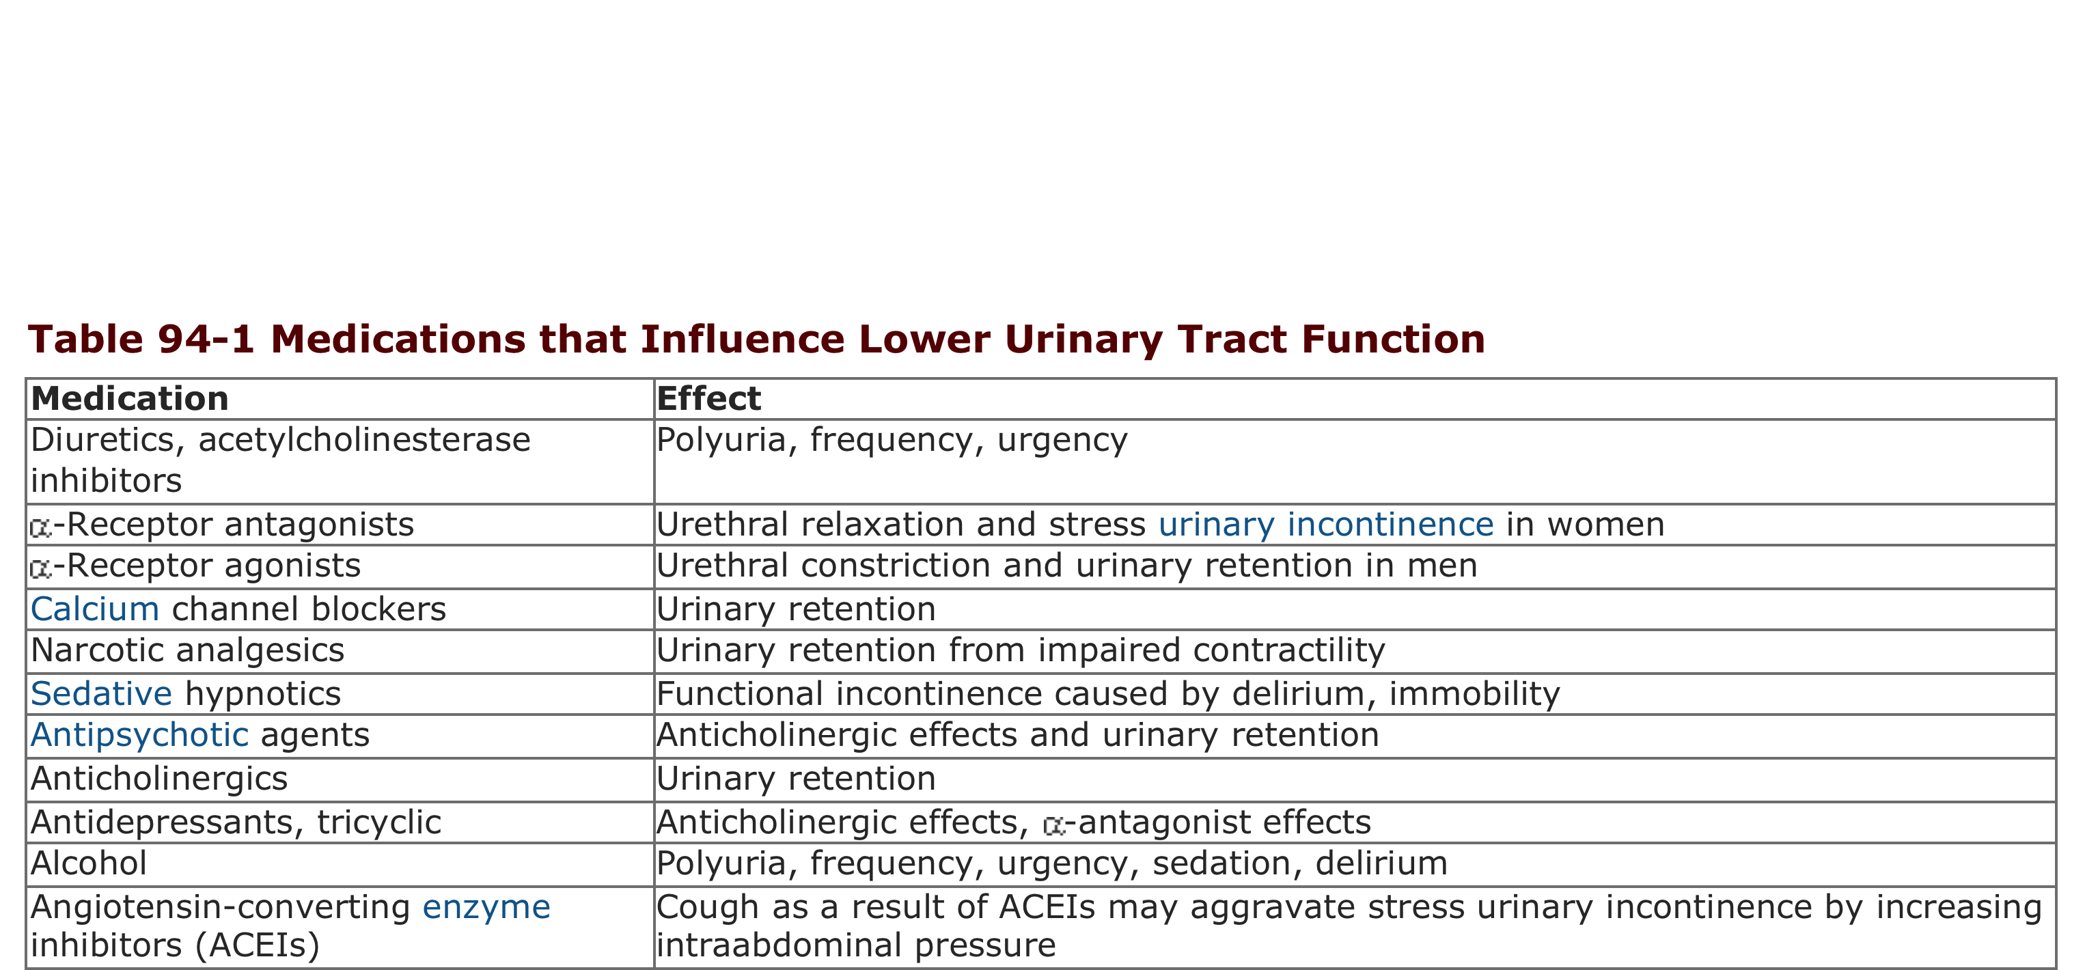

Slide 7
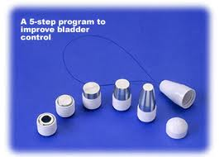
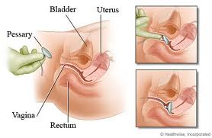
Non-Pharmacologic Treatment
Intervention | Description | Characteristics
Lifestyle | Eliminate risk factors | Fluid Smoking Weight Stress
Schedule | Time when to pee
Muscle rehab | Pelvic floor muscle contractions Vaginal weights (for females only)
Devices | Pessaries (for females only): support bladder neck Urethral compression device Pant alarms (SICK!): looks like a diaper

